Slide 1
Just Breathing isn’t enough: What your patients and Families need to hear
Jamie Lemmon, BSRT, RRT, RCP, AE-C Jamie.Lemmon@carolinashealthcare.org

Slide 2
Objectives
1) Why should CF patients exercise and stay active
2) Exercise during an exacerbation
3) The importance of having the “being active” conversation early
4) The importance of educating the family about the right order for the inhaled drugs
5) Tips and tricks to make that 45 minutes go faster for your toddler

Slide 3
What is Cystic Fibrosis
Cystic Fibrosis is a genetic disease and you get 2 copies of the defective gene. You get one gene from each of your parents.
It causes thick mucus in the lungs, pancreas, & liver
In the pancreas
Mucus prevents the release of digestive enzymes that help your body absorb nutrients
In the liver
Mucus blocks the bile duct causing liver disease

Slide 4
Cystic Fibrosis & CFTR Protein
Cystic fibrosis transmembrane conductance regulator (CFTR) is a protein that helps move chloride, water and other small molecules out of the cells
When this protein doesn’t work right the result is thick, sticky mucus
In the lungs
The thick mucus harbors bacteria that causes infection, lung damage and respiratory failure.
Cilia cannot easily move the mucus
This clogs the airways with mucus plugs
Makes I hard to remove particles and germs

Slide 5
Symptoms of Cystic Fibrosis
Salty skin
Persistent coughing
Frequent pneumonia or bronchitis
Wheezing or shortness of breath
Poor weight gain with good appetite

Slide 6
In the United States
30,000 people are living with cystic fibrosis
About 1,000 new cases each year
75% are diagnosed by age 2
More than half of the CF population is 18 years old or older
The average predicted survival age is close to 40
1950 children didn’t make it to elementary school
Cystic Fibrois Foundation. (n.d.). About Cystic Fibrosis . Retrieved from Cystic Fibrosis Foundation:
https://www.cff.org/What-is-CF/About-Cystic-Fibrosis/

Slide 7
Treatment
Treatment plans are individualized by type and severity of CF symptoms
Airway Clearance
Inhaled medicines
Enzymes
New drug development

Slide 8
What your patient and families need to hear: airway clearance
Explain why it is important
Why not to skip it
Increase how frequently they do it during an exacerbation
Running behind: deep breathing and huffing or coughing, PEP therapy can be done in the car.

Slide 9
How to make it fun
Favorite TV Show or movie
Read a story together
Play a game, talk about the day, or sing songs
Blowing or coughing games like blowing pinwheels or cotton balls
Minimize interruptions
Ask friends, siblings, or relatives to help

Slide 10
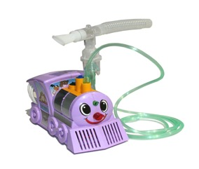
Order of Inhaled medications
Bronchodilators
Use 15 to 30 minutes before ACT
Use a spacer for MDI’s
Slow deep breath in, hold for 10 seconds, slowly exhale
Mucolytic
Hypertonic Saline
Dornase alfa
Mucus will be easier to move from the smaller airways into the larger ones to be coughed out

Slide 11
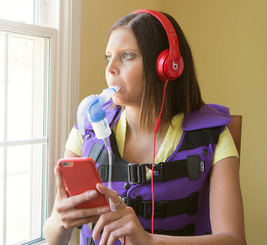
Order of inhaled medications continued
Inhaled Antibiotics
Used to fight or control bacteria
Usually 28 days on 28 days off
Corticosteroids

Slide 12
Exercise and CF
The benefit of being physically active
Slow the rate of decline in lung function
Helps clear mucus from the lungs
Creates more reserve meaning that normal activities can resume faster after being sick
Will help improve quality of life
Improves mood
Releases mucus, form of ACT

Slide 13
What kind of activities
Good habits start early
Be active as a family. A child will learn to enjoy hiking if they go on hikes with their parents even before they can walk.
Expose children to man types of activities this way they find what they like and they will be more likely to stick with it
3 things to look at
Do you like the activity & Does it work with your schedule
Its better with friends or family
Will it last at least 20 minutes and increase your heart rate

Slide 14
Things to think about when exercising
Exercise may cause them to cough
Urge huff coughs during and after exercise. This will help release more mucus compared to regular coughing
Drink plenty of fluids. During hot weather, a person with CF may lose large amounts of sodium and chloride through sweat. Sports drinks contain sodium and chloride.
Talk to a dietitian, exercise physiologist, or doctor about carbohydrate intake if they have CF related diabetes

Slide 15
Exercising with cystic fibrosis
Exercise capacity decreases by 20% by the age of 18 years old
Associated with reduced pulmonary function, nutritional status, daily physical activity levels, chronic infection, and inflammation
Regular moderate aerobic exercise has been suggest to have anti-inflammatory effects in healthy patients.
Increases circulating numbers of anti-inflammatory regulatory T cells in healthy patients
Moderate intensity exercise could exert different inflammatory responses in patients with chronic inflammatory conditions or when done during active disease.

Slide 16
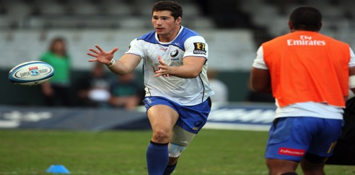
Athletes with CF
Lisa Bentley has won 11 Ironman competitions
Nolan Gottlieb is a former NCAA basketball player
Nathan Charles is an Australian rugby player

Slide 17
Kelsie Jeffords
America’s Got Talent
Diagnosed when she was 1 month old
Started dancing at 3 years old

Slide 18
Vicki Thompson & Jeremy Thompson
Snowboarding
Diagnosed when she was 2 years old
Snowboarding
Competes in the global snowboarding circuit
Diagnosed soon after birth

Slide 19
Susie Q
Admitted to LCH for 2 weeks for a tune up.
At the beginning she's happy but by the end she wants the room dark and she doesn’t want to much other than watch TV.

Slide 20
Education & Exercise at Levine Children’s Hospital
The Team
RT
RN
PT
Pulmonologist
Child life
Dietary
Infection Disease RN

Slide 21
A grant for 3 Treadmills, 2 stationary bikes, 2 elliptical, and several exercise peddlers
On a first come bases our CF patients can pick what exercise equipment they would like to keep in their room to use while they are in the hospital
Our CF patients are encouraged to exercise for 20 minutes every day while in the hospital
They can be out of the room if they are with a
caregiver to walk the halls, or walk the stairs

Slide 22
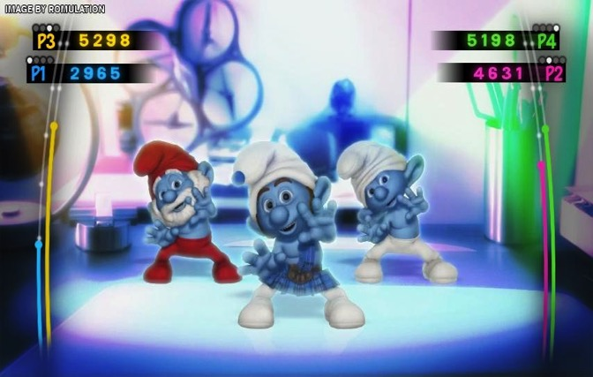
Too young for exercise equipment… No problem
Trash Can Soccer
Wii dance party
Balloon toss
Nerf War

Slide 23
By getting them moving we noticed
Happier at the end of 2 weeks
Making competition out of exercise
Motivating each other
Making friends

Slide 24
Conclusion
Exercise is beneficial for healthy individuals as well as in individuals with cystic fibrosis.
It could decrease the amount of inflammatory mediators
Exercising during an exacerbation could help with airway clearance
Improved quality of life

