Slide 1
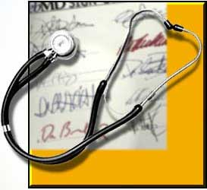
What does a Respiratory Therapist do?
Respiratory Therapists work to evaluate, treat, and care for patients with lung and heart disorders.

Slide 2
What kinds of patients do Respiratory Therapists Treat?
Lung disease patients
Heart patients
Neuromuscular patients
Accident victims
Premature babies
Children
Adults
The elderly
© 1998 Random House. Used with permission.

Slide 3
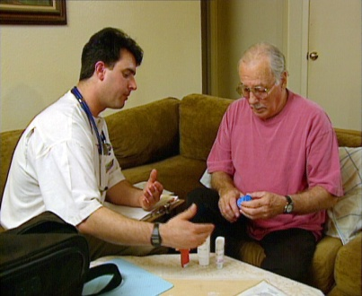
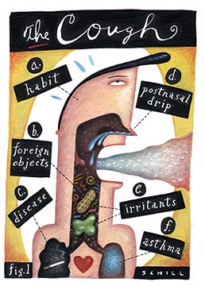
What Breathing Disorders Do Respiratory Therapists Treat?
Asthma
Bronchitis
Emphysema
Chronic Obstructive Pulmonary Disease
Cystic Fibrosis
Chest Trauma
Pneumonia
Acute Respiratory Distress Syndrome

Slide 4
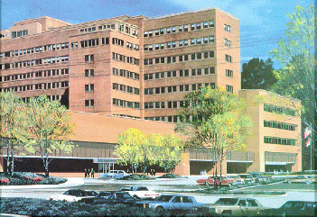
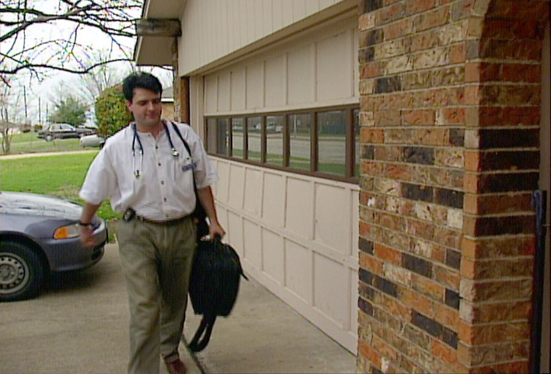
Where Do Respiratory Therapists Work?
Acute care hospitals
Patient transport
Diagnostic laboratories
Rehabilitation and skilled nursing facilities
Patient’s homes
Educational institutions
Industry

Slide 5
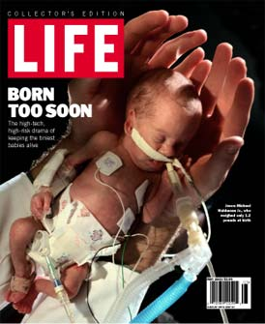
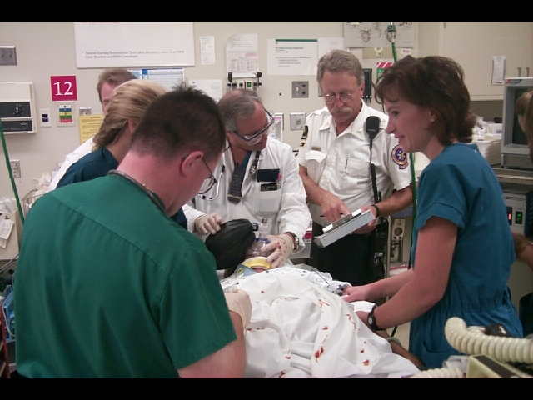
Where do RRTs work?
The level of illness and setting of patients can vary widely. From patients in the neonatal intensive care unit…
© 2000 Time Inc. Used with permission.
to victims of trauma in the emergency room.

Slide 6
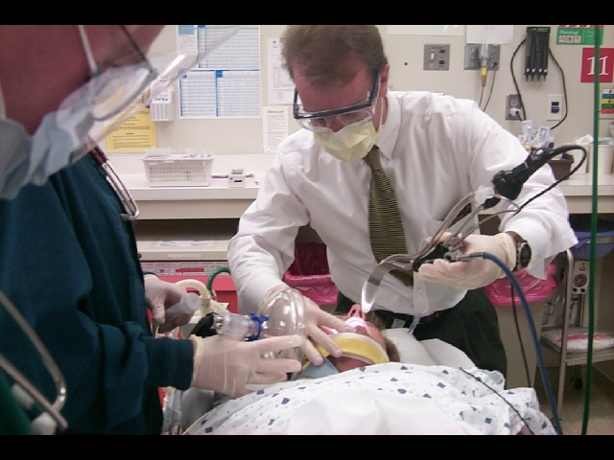
In the ER it all starts with Respiratory, and the ABCs of CPR…
Airway
Breathing
Circulation
The airway is always established first.

Slide 7
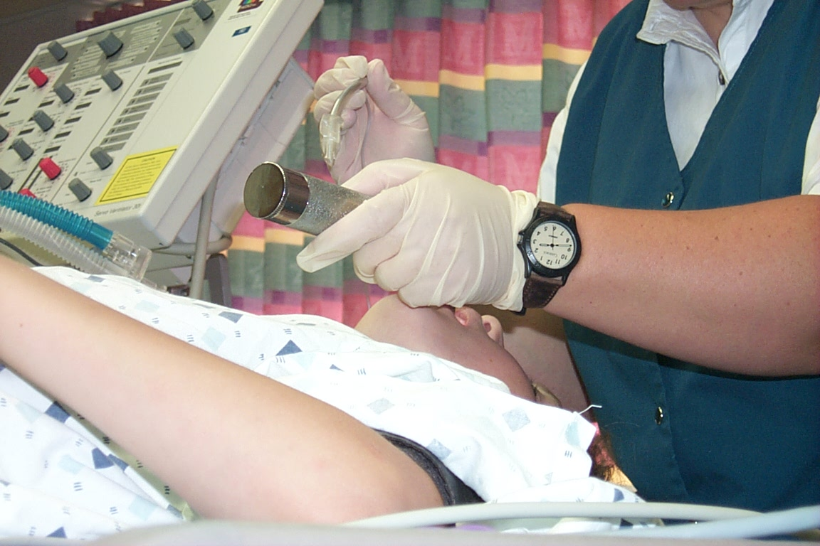
Where do Respiratory Therapists Work?
With the use of breathing machines designed for artificial ventilation, the respiratory therapist is an integral part of the Intensive Care Units.

Slide 8
The Respiratory Therapist is a vital part of the lifesaving transport team that answers patient emergencies.

Slide 9
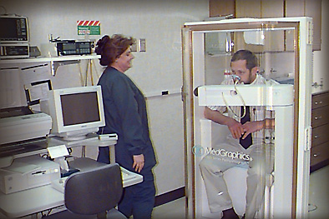
Respiratory Therapists Perform Diagnostic Procedures
Pulmonary function studies
Arterial blood gas analysis
Hemodynamic monitoring
Sleep studies
EKGs and cardiac tests
Stress and exercise testing

Slide 10
Respiratory Therapists Perform Therapeutic Procedures
Mechanical Ventilation
Oxygen administration
Medication administration
Chest physiotherapy
Lung expansion therapy
Pulmonary rehabilitation
Smoking cessation

Slide 11
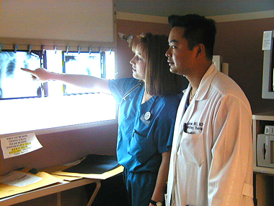
Respiratory Therapists interact with pulmonologists and physicians specializing in trauma resuscitation, critical care, and pulmonary and cardiac rehabilitation.

Slide 12
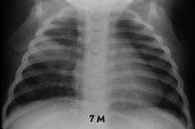
Therapists help physicians with the diagnosis and management of respiratory disease

Slide 13
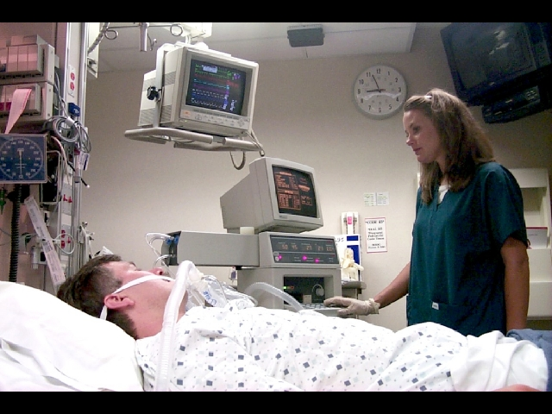
Respiratory Therapists have a unique role...
- Patient Care - Clinical Consultant - Technical Consultant

Slide 14
Career opportunities are EXCELLENT!
The need for RRTs is growing due to:
increase in elderly population
the impact of our changing environment on diseases
technology advancements
advances in treatment of premature babies
smoking and COPD
Retirement!

Slide 15
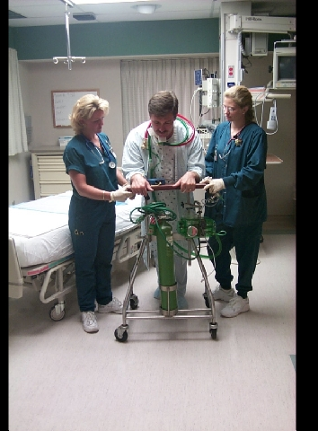
Who succeeds in Respiratory Therapy?
A person who is high tech and high touch.
Therapists handle both the technical side of life-threatening situations as well as provide support, reassurance, and education for patients and their families.

Slide 16
Is Respiratory Care For Me?
A career as a respiratory therapist can provide:
the ability to make a difference in peoples lives
a high tech and exciting career
recognition, respect, and appreciation
a great job at a good salary
job security
A rewarding career for life!
What should I be?

Slide 17
What is the earning potential?
Money magazine rated Respiratory Therapy the 13th fastest-growing, most desirable job to have through the year 2005.
The median annual earning is $32,500 according to the BLS.
Starting salaries range from $15-$22 per hour.

Slide 18
What Courses Do I Need to Prepare for an RC Education Program?
Prerequisite coursework
varies upon which degree
program you enter, but
students should have a
strong background in Math and Science.

Slide 19
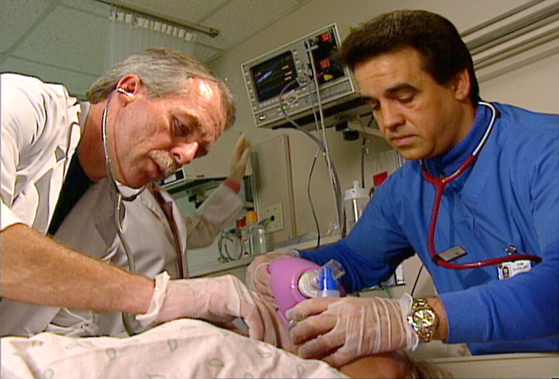
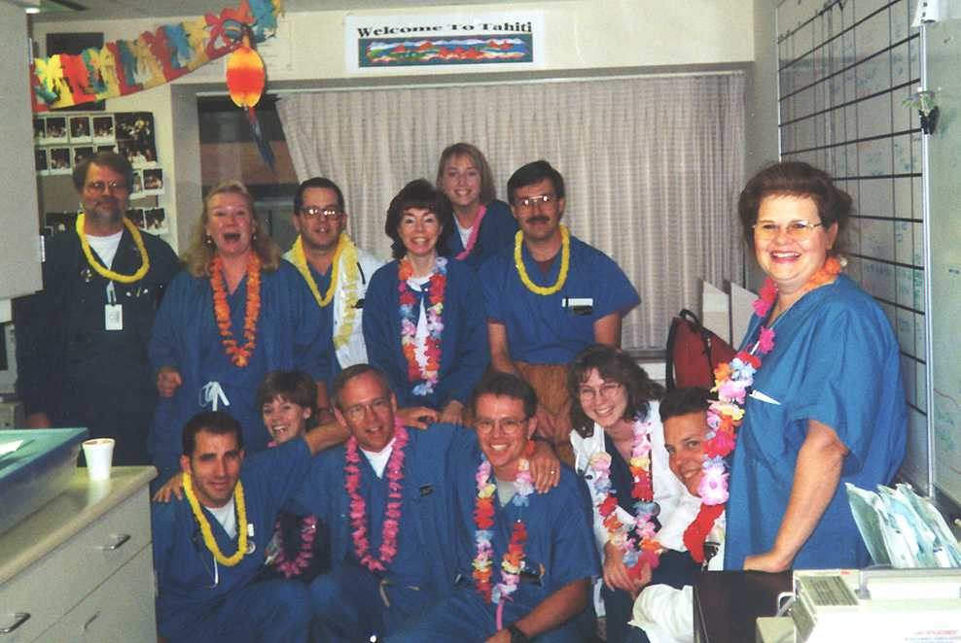
Respiratory Care…
a Life and Breath Career for You!
You can live without food for a week, without water for a day, but you cannot live without air for more than a few minutes.

Slide 20
How many programs are there?
More than 400 community colleges and universities nationwide offer respiratory care programs.
All aspiring respiratory therapists must take courses in physics, mathematics, microbiology, anatomy and physiology, chemistry, and biology.

Slide 21
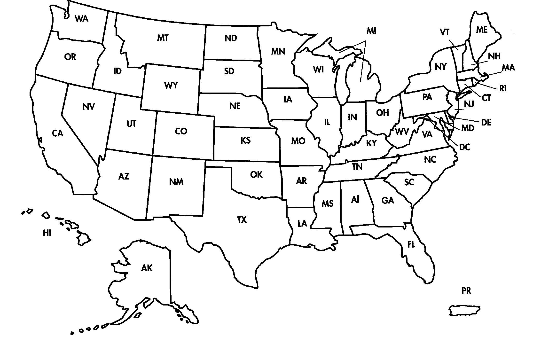
2
1
1
3
1
6
1
2
2
3
1
1
1
2
3
2
2
1
1
1
2
1
2
3
5
2
2
1
55 Respiratory Therapy Programs Awarding a Bachelor of Science Degree in Respiratory Therapy
2/1/02

Slide 22
What are the Educational and Training requirements?
There are two levels of respiratory therapist: the certified respiratory therapist and the registered respiratory therapist.
Respiratory therapists are required to complete either a two-year associate's degree or a four-year baccalaureate degree. Upon graduation they are eligible to take a national voluntary examination that, upon passing, leads to the credential:
Certified Respiratory Therapist (CRT).
Subsequently they may take two more examinations that lead to the credential:
Registered Respiratory Therapist (RRT

Slide 23
Entry Level Staff Therapist- Certified Respiratory Therapist (CRT)
Educational Preparation: AAS or BS, MS in respiratory care with inservice and/or continuing education appropriate to the specialty. Entry-level Certification is required for all roles.
Inpatient and outpatient settings in which staff therapist may function under the supervision of an advanced practitioner:
Ambulatory/Outpatient Care
Emergency and Triage
Home Health
Long Term Care and Geriatrics
Operating Room
Pediatrics
Critical Care Units
Medical and Surgical
Post Anesthesia Care
Cardiac Care
Thoracic Surgery
Pulmonary and Cardiac Rehabilitation

Slide 24
Advanced Practice- Registered Respiratory Therapist
Educational Preparation:
AAS or BS or MS in respiratory care with inservice and/or continuing education appropriate to the specialty.
Entry-level Certification is required for all roles with accompanying RRT credential.

Slide 25
Educator
Educational Preparation in practice settings: **BS with an advanced practitioner standing (RRT) with MS preferred. All other require minimum of AAS with RRT
Program Director**
Clinical Director**
Clinical Preceptor
Asthma Educator

Slide 26
Patient Educator/Health Educator/Wellness Programs
Staff Development/Continuing Education**
Educational Preparation in academic settings: in Associate and Diploma programs a BS is required; MS is preferred in universities and institutions of higher learning a PhD is preferred and an MSN is required

Slide 27
Specialty Roles Educational Preparation: BS or higher degree with role-specific continuing education preferred
Pharmaceutical
Researcher
Medical Supply Sales
Clinical Trials
Recruiter
Editor/Author
Elected Officials/Policy Makers/Lobbyists
Entrepreneur
Expert Witness
Federal/Armed Services (contains many RT roles/positions)
Transport/Flight
ECMO Specialis
Case Manager
Public Health
Quality Improvement/Continuous Improvement/Risk Management
Consultant
t

Slide 28
Respiratory Management
Educational Preparation: AAS in respiratory therapy with an additional BS degree required by most institutions, MS or higher degree preferred in large centers.
Department Manager
Chief Therapist
Clinical Manager
Coordinators for speciality areas
Pediatrics
Neonatal
Diagnostics
Critical Care
Sleep lab
Pulmonary Rehabiltation
Home Care Respiratory Manager

Slide 29
Where can NC students earn there BS Degrees? BSHS or BSAST or BSRRT
NC Programs (BSHS)
UNC-G
North Carolina Central University
Winston Salem State University
Other programs AARC endorsed:
Empire State College
Northern Arizona University
Thomas Edison State College
California College of Health Sciences
George Washington University
Touro University International

Slide 30
What Professional RC Organizations are located in NC?
NCSRC-AARC affiliate
NCRCB-Licensing Board

Slide 31
The North Carolina Society for Respiratory Care (NCSRC )
The NCSRC is a non profit organization that supports and benefits the Respiratory Care Practitioners of North Carolina.
The NCSRC is a chartered affiliate of the American Association for Respiratory Care (AARC)

Slide 32
North Carolina Respiratory Care Board
The NCRCB is a non profit organization that licenses Respiratory Care Practitioners of North Carolina.
According to the NC General Assembly, the practice of respiratory care in the State of North Carolina affects the public health, safety, and welfare and that the mandatory licensure of persons who engage in respiratory care is necessary to ensure a minimum standard of competency.
It is the purpose and intent of Respiratory Care Practice to protect the public from the unqualified practice of respiratory care and from unprofessional conduct by persons licensed.

Slide 33
Need more information? Try these Websites!
AARC: www.aarc.org
NCSRC: www.ncsrc.org
NCRCB: www.ncrcb.org
NBRC: www.nbrc.org
CoArc: www.coarc.com

